Slide 1
Demystifying HuggingFace, LangChain, and LlamaIndex
- by Tarek A. Atwan

Slide 2
Table of Contents
Table of contents
What is Hugging Face
Demo: Exploring Hugging Face
Demo: Hugging Face API
What is LangChain
Demo: LangChain reading a PDF file
Demo: LangChain to Query a Database/Pandas
Demo: LangFlow
What is LlamaIndex
Demo: LlamaIndex to Query a Database/Pandas
Q&A

Slide 3

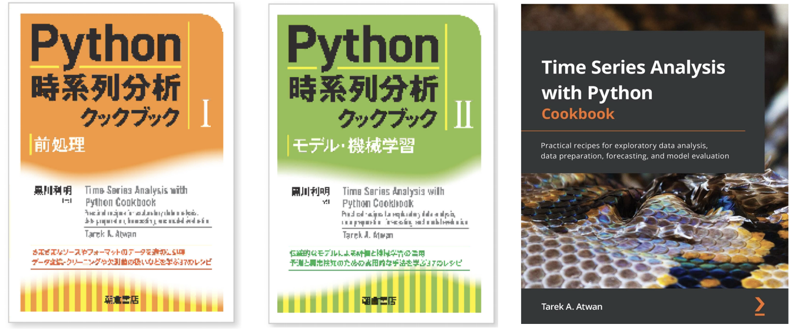
Brief about me..
My name is Tarek Atwan
AI/ML Consultant
~17 years of work experience in Analytics (NAM & EMEA)
~5 years of teaching & mentoring (2U, Pluralsight, Thinkful)
Book Author, ”Time Series Analysis with Python Cookbook” by Packt Publishing

Slide 4

The era of ChatGPT
Brief about me..

Slide 5
Hugging Face

Slide 6

What is Hugging Face
Brief about me..
Think of it as GitHub but for AI/ML folks
Committed to the Open Source Community
Democratize AI/ML to the masses
Started off with its Transformers library
Now, Hugging Face consists of many components:
Transformers Library
Tokenizers Library
HuggingChat
Hugging Face Hub (Git Repositories)
Datasets
Models
Spaces (ML apps made by the community)
Learn (Courses on NLP and Deep RL)

Slide 7
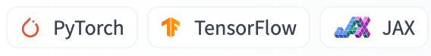
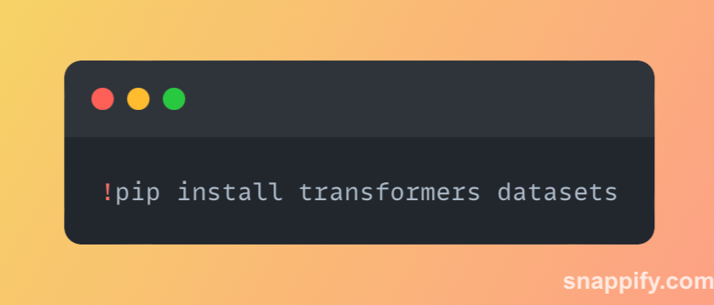
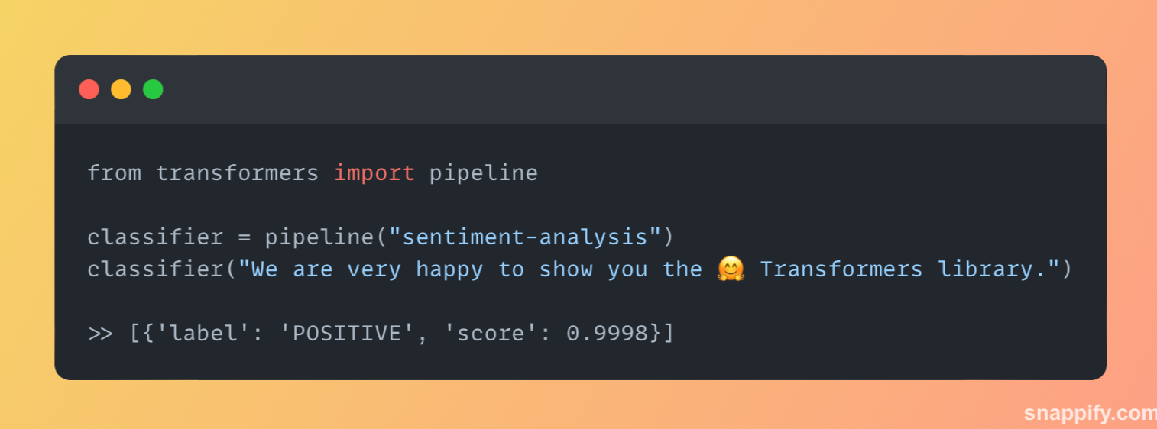
Hugging Face Getting Started
Brief about me..
Supports:
Easy install:
Easy to use:

Slide 8
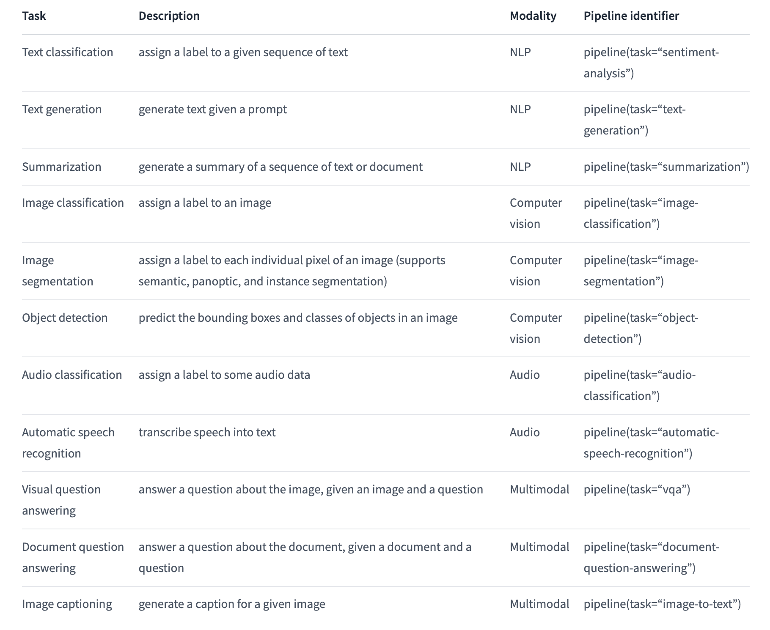
Hugging Face Task
Brief about me..

Slide 9
Exploring Hugging Face & Coding Demo

Slide 10
LangChain

Slide 11

What is LangChain
Brief about me..
It is a framework
LangChain wants to simplify the development of applications powered by language models
Supports Prompt Templates
Makes it easy to swap different models (LLMs)
Provides chains for creating a pipeline
Makes it easy to query datasets with natural language in variety of formats: CSV files, SQL Databases, or pandas DataFrames

Slide 12
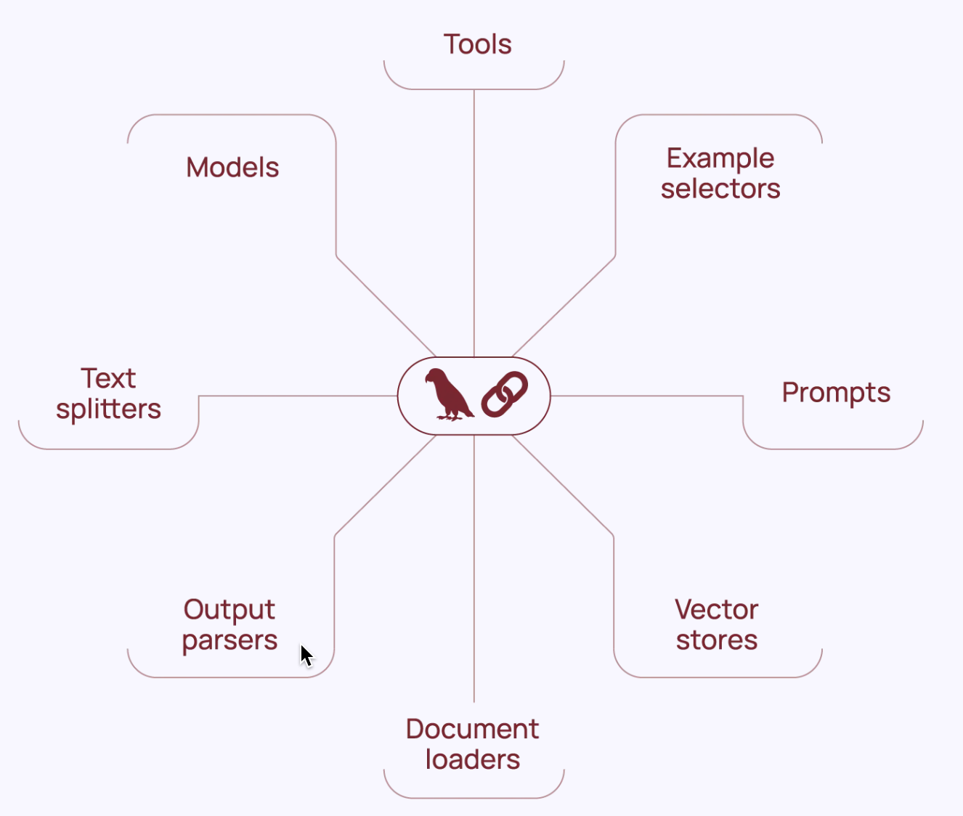
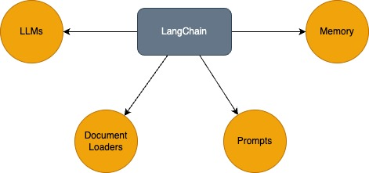

What is LangChain
Brief about me..

Slide 13

What is RAG
Brief about me..
“Retrieval-Augmented Generation (RAG) is the process of optimizing the output of a large language model, so it references an authoritative knowledge base outside of its training data sources before generating a response”
“ RAG extends the already powerful capabilities of LLMs to specific domains or an organization's internal knowledge base, all without the need to retrain the model. It is a cost-effective approach to improving LLM output so it remains relevant, accurate, and useful in various context”
Source

Slide 14
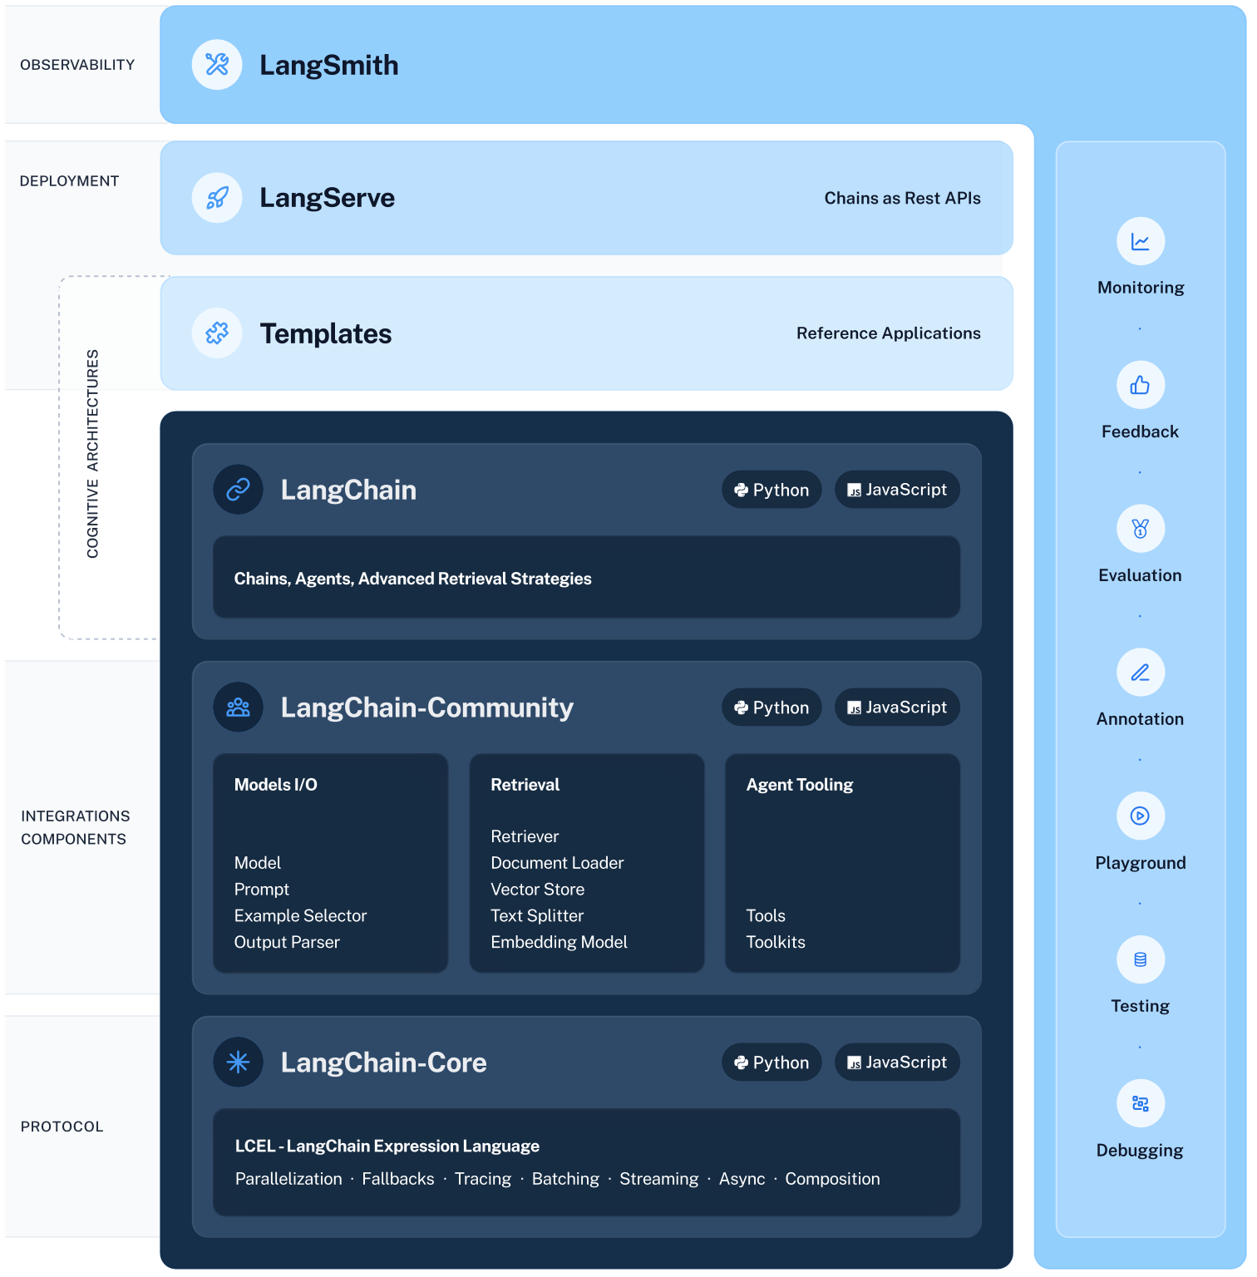
LangChain Components
Brief about me..
LangChain Libraries
LangChain
LangChain-Core
LangChain-Community
LangChain Templates
LangServe
LangSmith
LCEL (LangChain Expression Language)

Slide 15
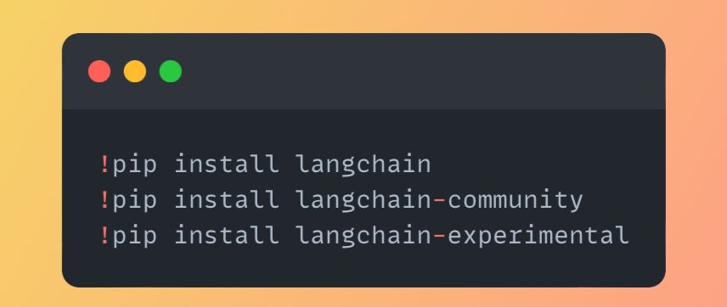
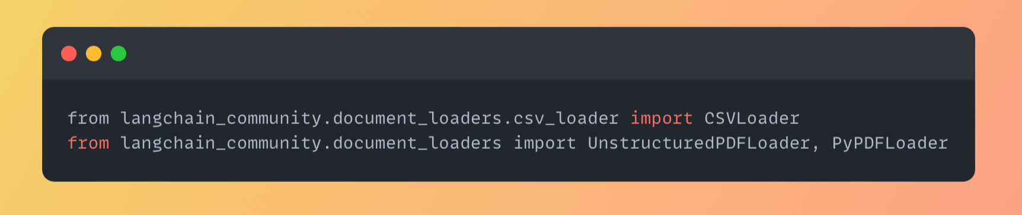
LangChain Getting Started
Brief about me..
Easy install:
Document Loaders

Slide 16
LangChain Coding Demo

Slide 17
LlamaIndex

Slide 18
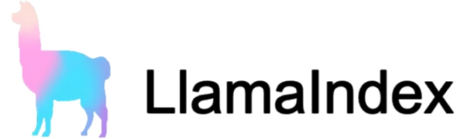
What is Hugging Face
Brief about me..
It is a framework
LlamaIndex wants to simplify the development of applications powered by language models
Focuses on RAG use cases
Excels in search, data indexing and retrieval

Slide 19
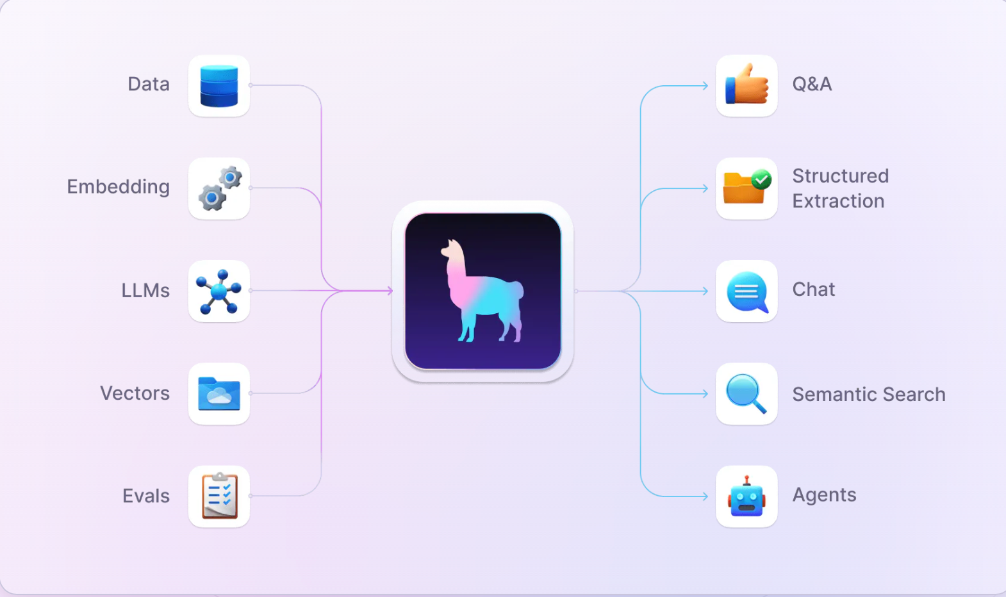
What is Hugging Face
Brief about me..

Slide 20
LangChain Getting Started
Brief about me..
Easy install:
Document Loaders

Slide 21
LLamaIndex Coding Demo

Slide 22
DataHour : Q&A

Slide 23
Thank you!

